Slide 1

Traffic crashes and injuries forecast
Time Series Final Project
Team 5
05/22/2024
Wednesday
Aayush Verma
Ashmita Mukherjee
Mitali Dighe
Jahanvi Reddy

Slide 2
Agenda
Problem Statement
Business Objective
Data Overview
Exploratory Data Analysis
Experimental Analysis
Modeling Crashes and Injuries
Model Selection
Results
Future Scope

Slide 3

Problem Statement
Traffic collisions in urban areas pose significant challenges to public safety and place a heavy burden on emergency response systems
To enhance public safety and optimize resource allocation, this project aims to analyze historical traffic collision data and the injuries caused due to these crashes

Slide 4

Business Objective
The primary goal of this project is to develop forecasting models that can accurately forecast the frequency of traffic collisions and accidents
We also want to predict injuries along with the traffic crashes
These predictions will assist law enforcement agencies and healthcare facilities in anticipating periods of increased workload, thereby enabling better preparedness and response strategies

Slide 5
Data Overview
The dataset is recent and has crash and injuries data with timestamps from 1st January 2021 to 30th April 2024
We downsampled the data and analyzed by creating the time series in 3 sampling rates: Monthly, Weekly and Daily
Daily sampling is the most beneficial way to go according to our use case of aiding law enforcement and medical professionals

Slide 6
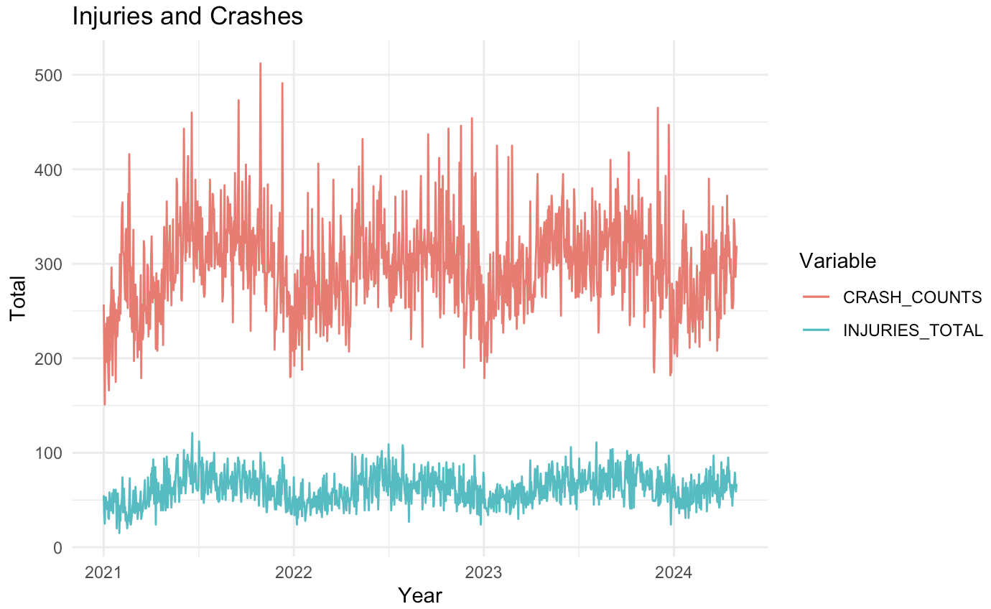
Exploratory Data Analysis
Crashes and Injuries over time
There is no specific trend. However, we can see seasonality in both crashes and injuries
Time Period: January 21 to April 2024. We can see volatility and fluctuations in data
Within the year, we can see there could be a possibility of multiple seasonal components
Periodograms can help us identify the potential multiple seasonal components

Slide 7
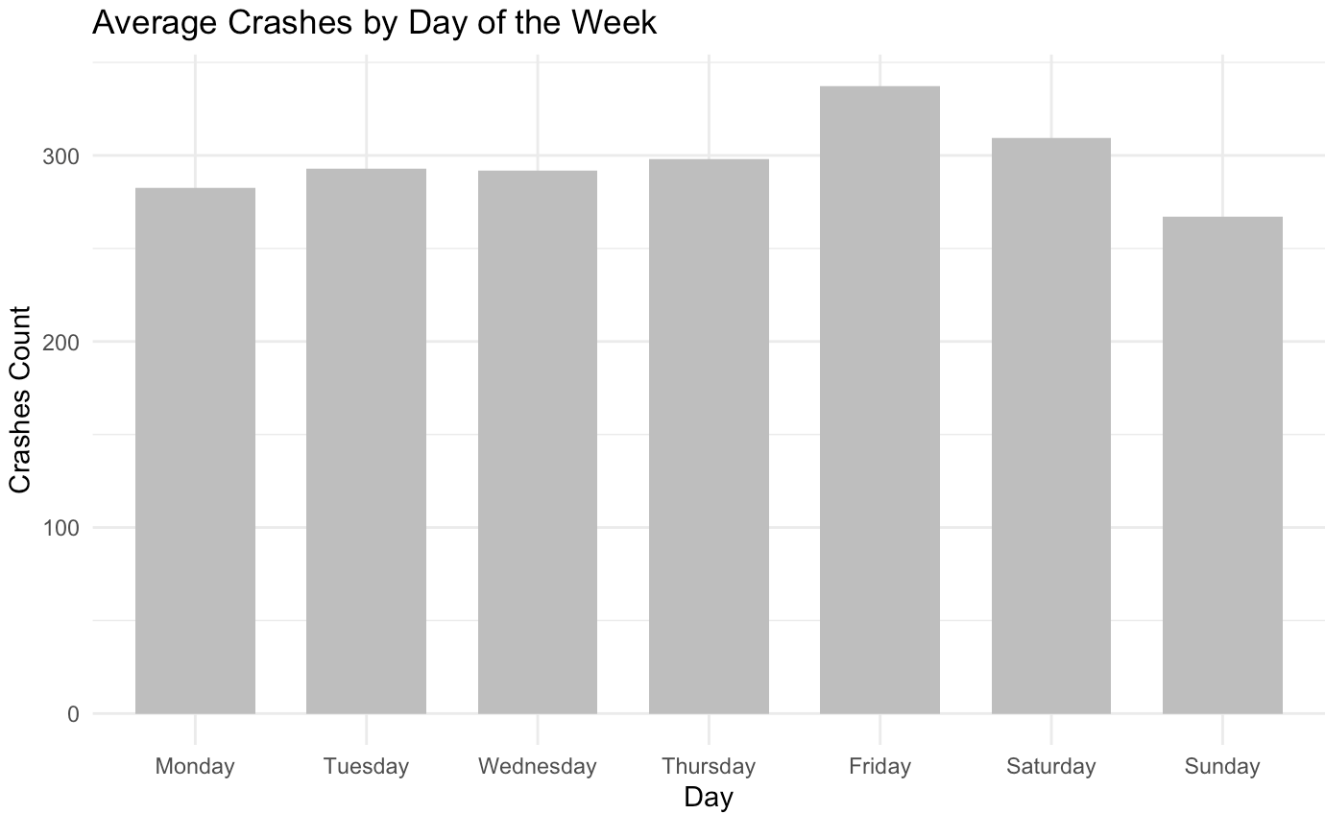
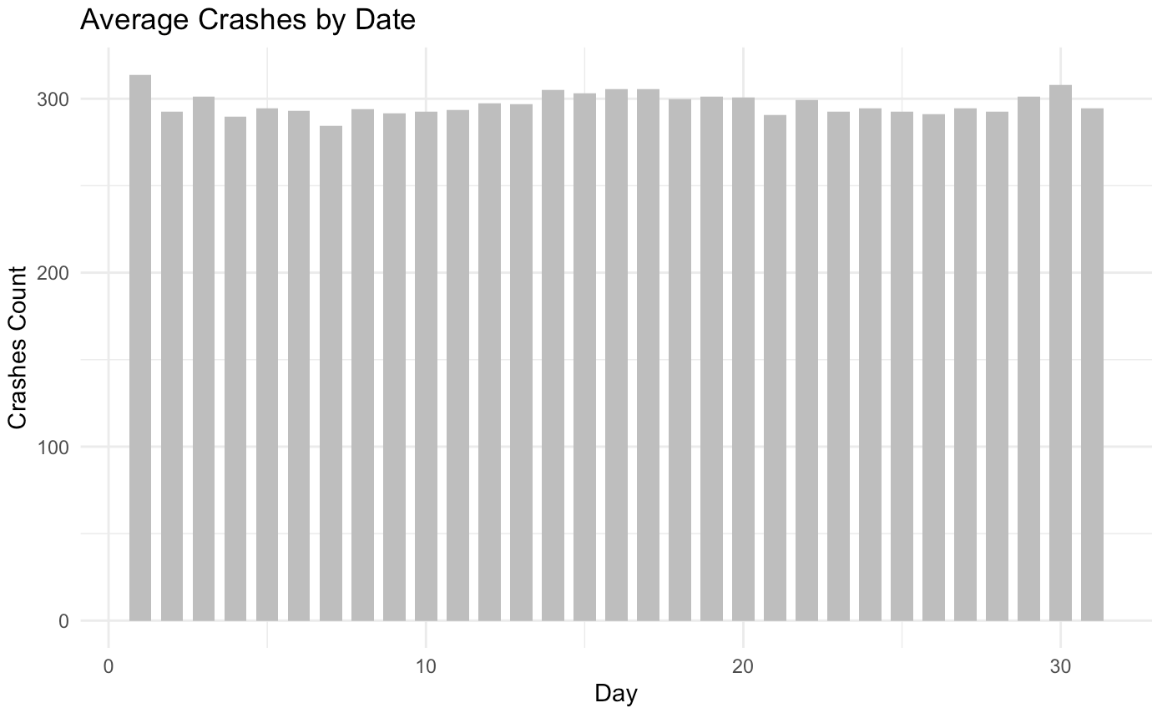
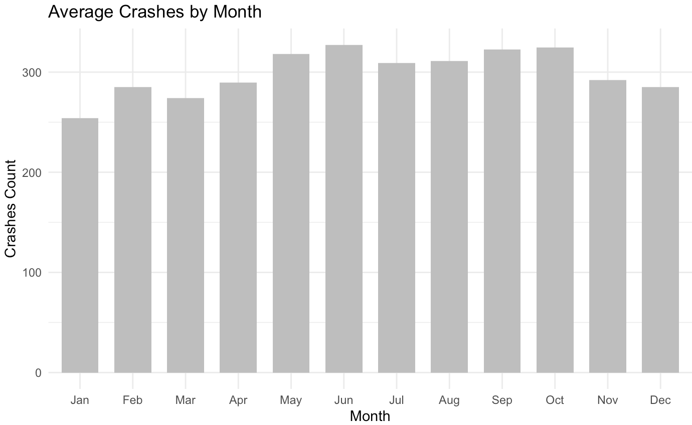
Exploratory Data Analysis
Exploratory Data Analysis
Day
Week
Month
On an average, 285 to 315 traffic crashes are observed
Higher number of crashes are observed on 30th and 1st of the months
This could be because more people go out at the beginning or end of the month
On an average, 254 to 327 traffic crashes are observed
Highest traffic crashes are observed in the month of June
This could be because more people go out in summers
On an average, 267 to 337 traffic crashes are observed
Highest traffic crashes are observed on Fridays and Saturdays
This could be because more people go out on weekends (Friday and Saturday nights)

Slide 8
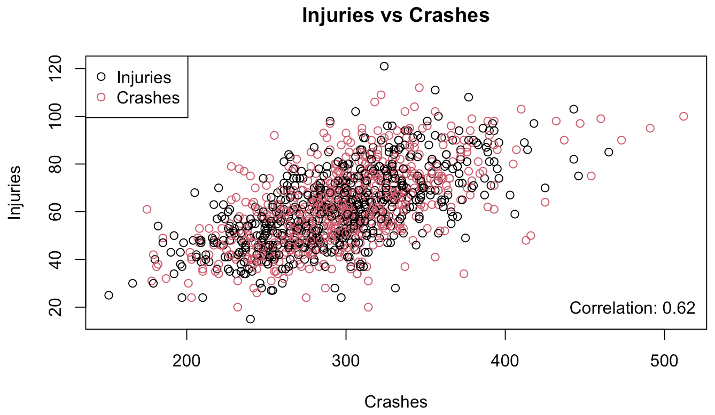
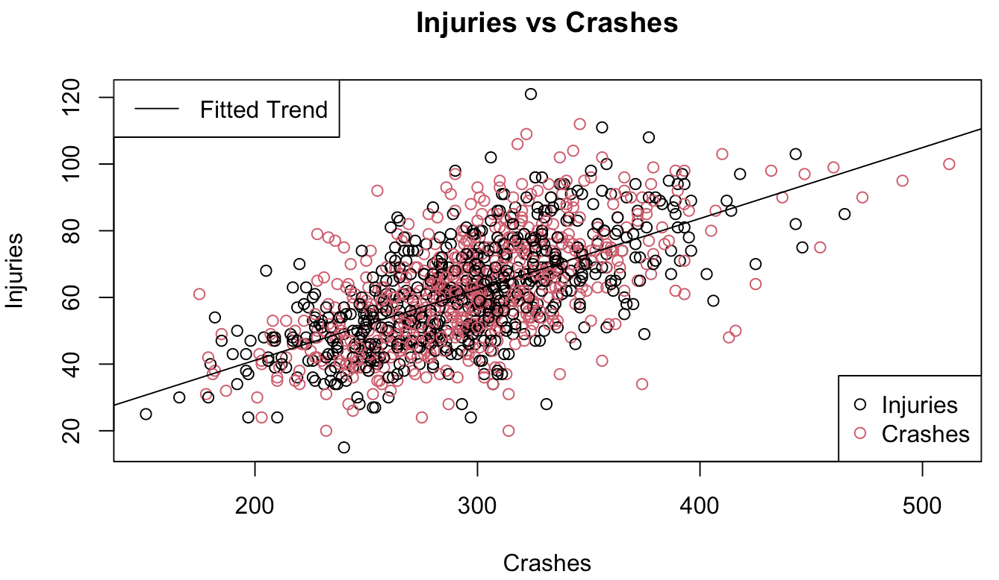
Exploratory Data Analysis
Crashes vs Injuries - Correlation
Crashes vs Injuries – Fitted Trend
Injuries have a positive correlation with crashes
We can see the correlation between crashes and injuries is ~0.62
A simple linear regression model to fit a trend
Observe the data along with the fitted trend

Slide 9
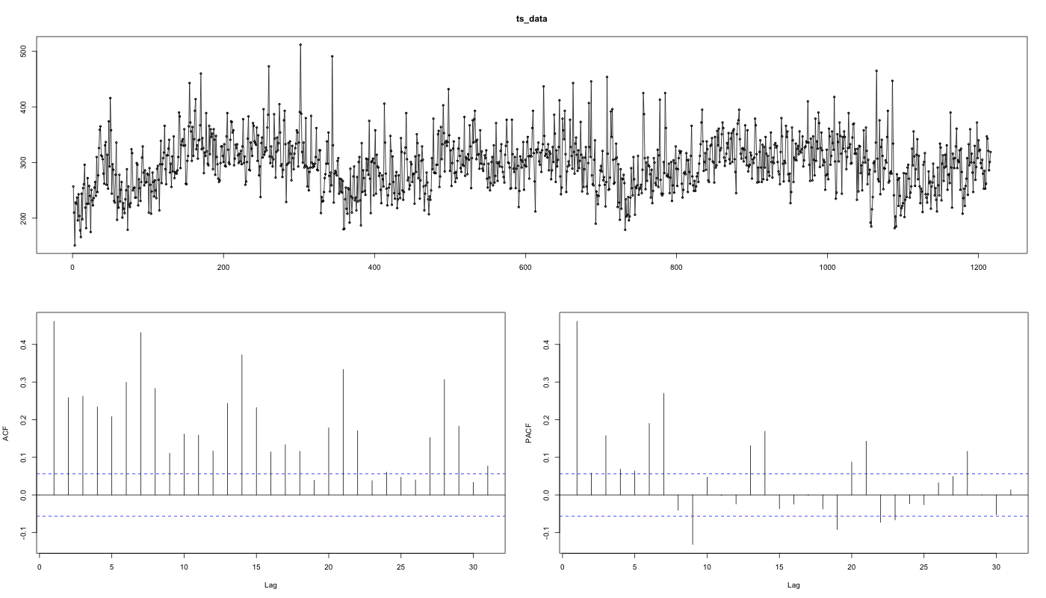
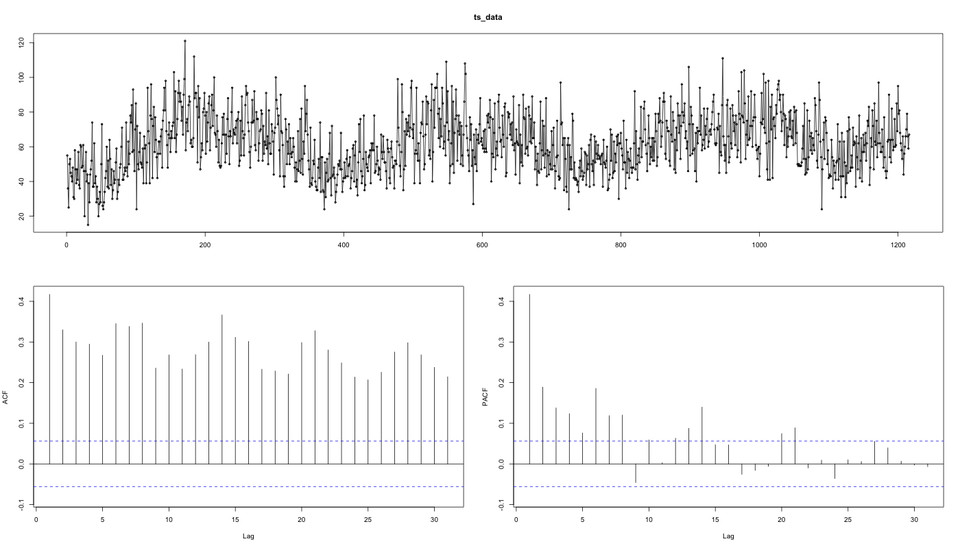
Experimental Analysis
To analyze trends and patterns, we converted the crashes and injuries data into time series objects. The below ACF and PACF plots are observed.
For both crashes and injuries, the time series are clearly not stationary with multiple significant lags. It would require us to do multiple seasonal differencing to achieve stationarity. The ACF plot is dragging and the PACF also shows multiple significant lags.

Slide 10
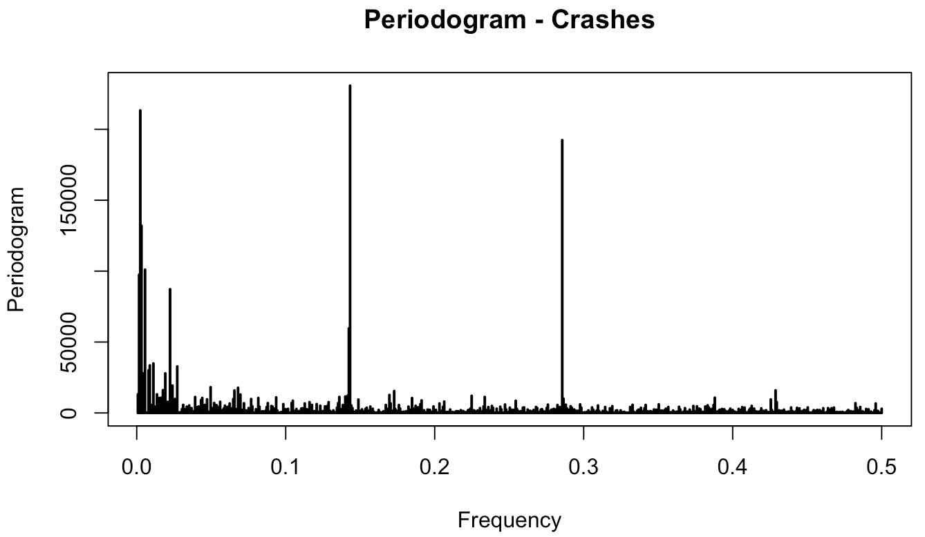
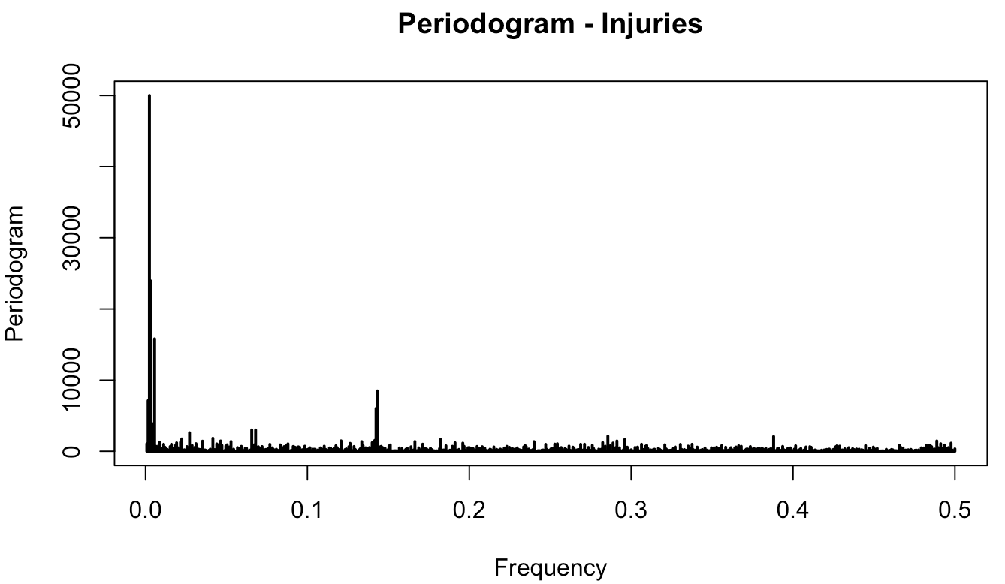
Experimental Analysis
By conducting an exhaustive spectral analysis of the injuries and crashes data, multiple seasonal components have been observed in both the time series.
4 Seasonal components:
5, 7, 183, 365 (Days)
2 Seasonal components:
7, 365 (Days)

Slide 11
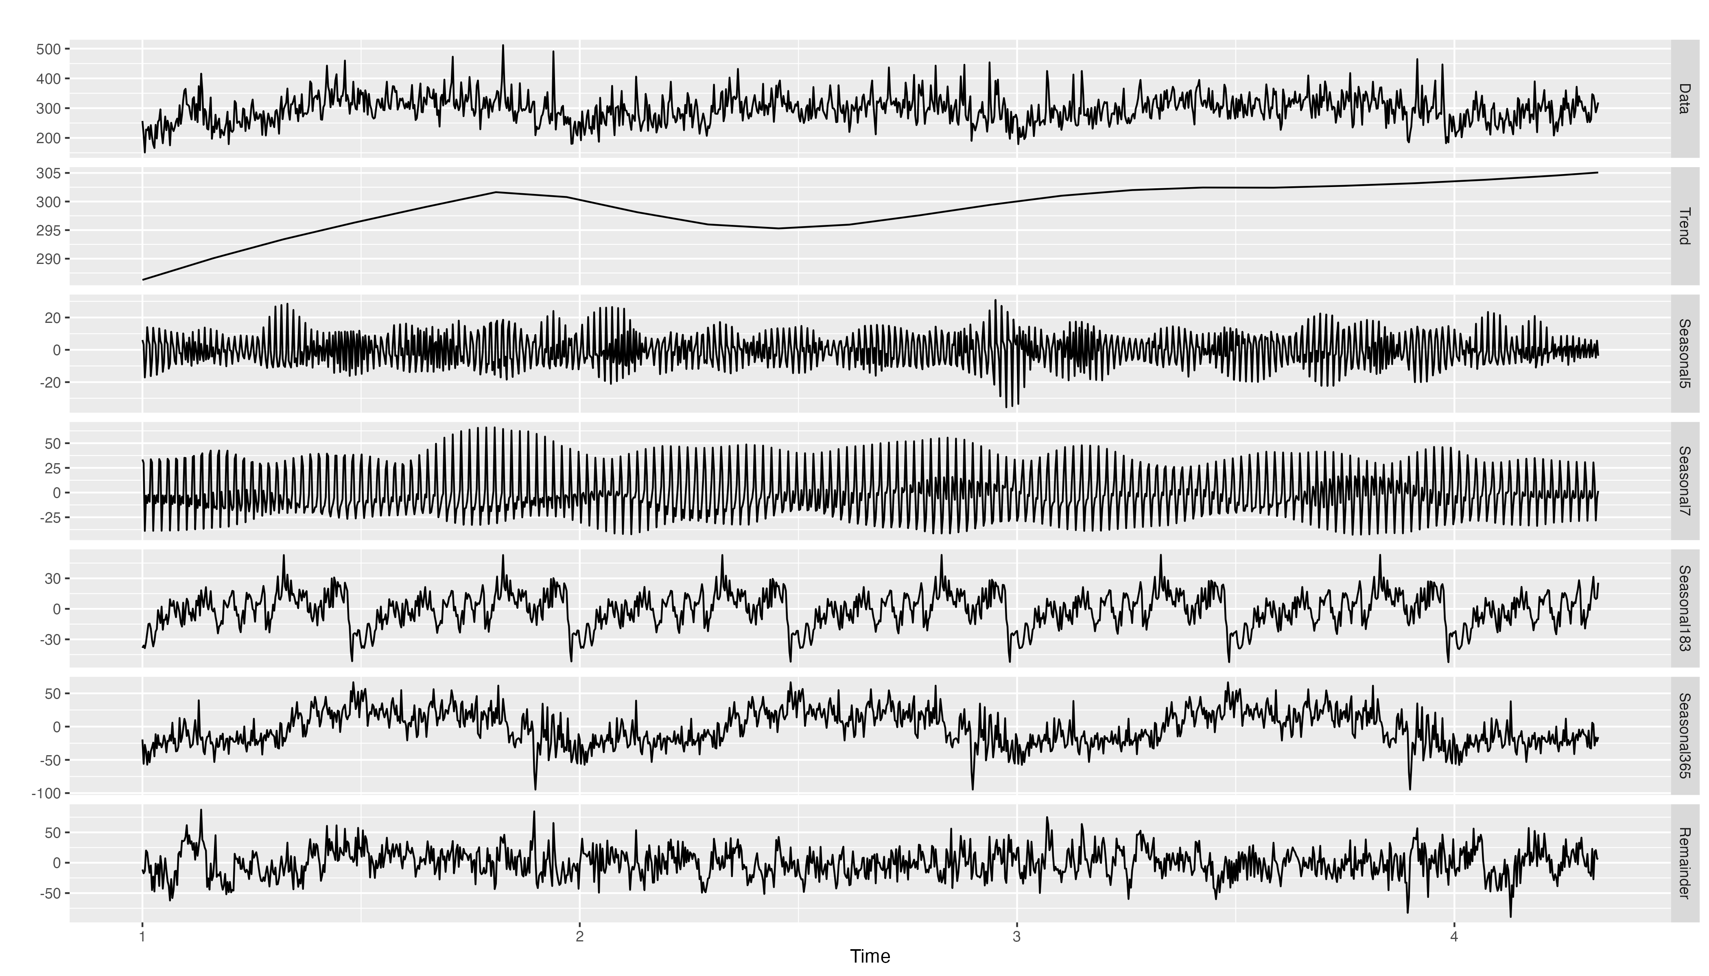
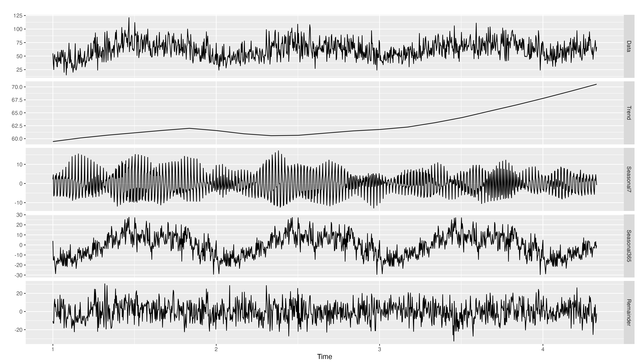
Experimental Analysis
To understand the underlying patterns in our data, we performed a multi-seasonal time series decomposition using the mstl() function for both injuries and crashes into seasonal, trend and remainder components.
CRASHES: Identified multiple seasonality, including 5-day, weekly, biannual and yearly patterns
INJURIES: Identified weekly and yearly seasonal patterns.

Slide 12
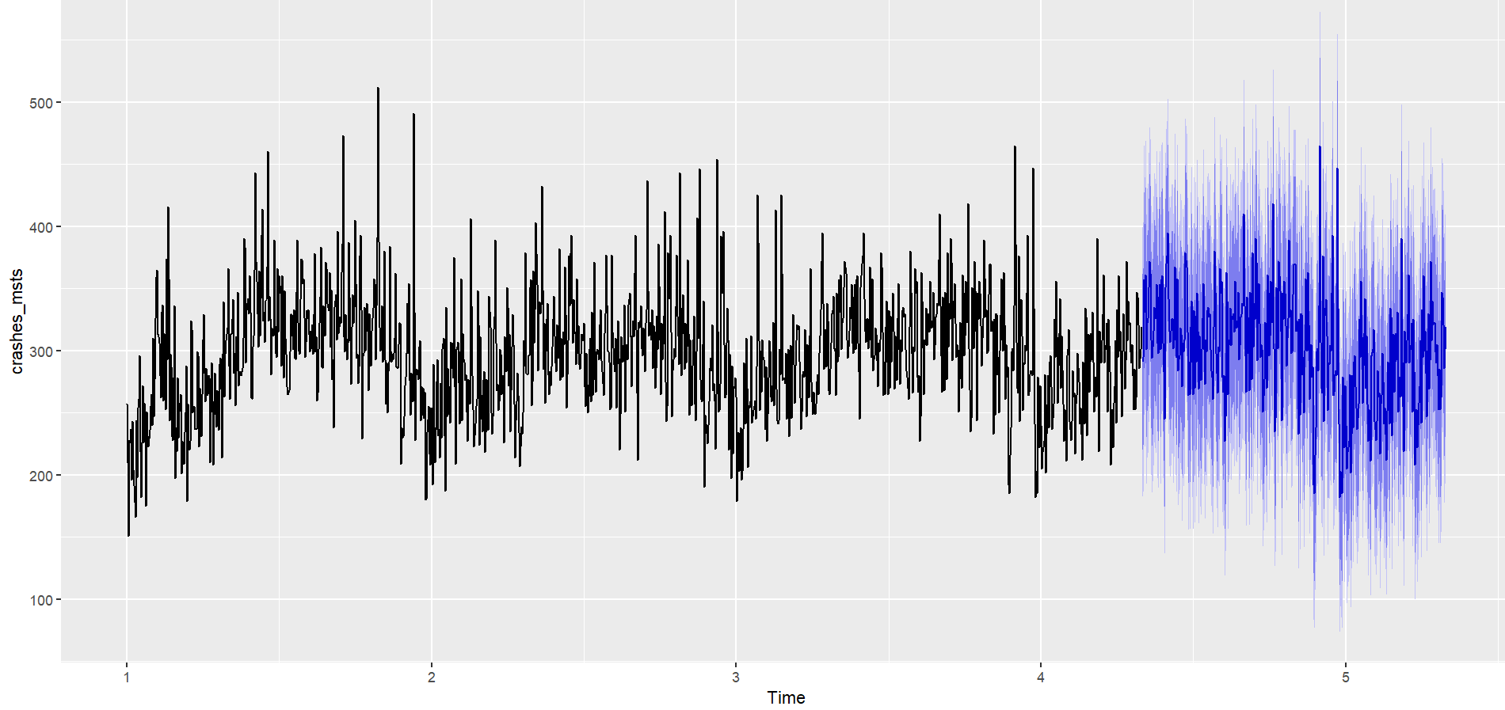
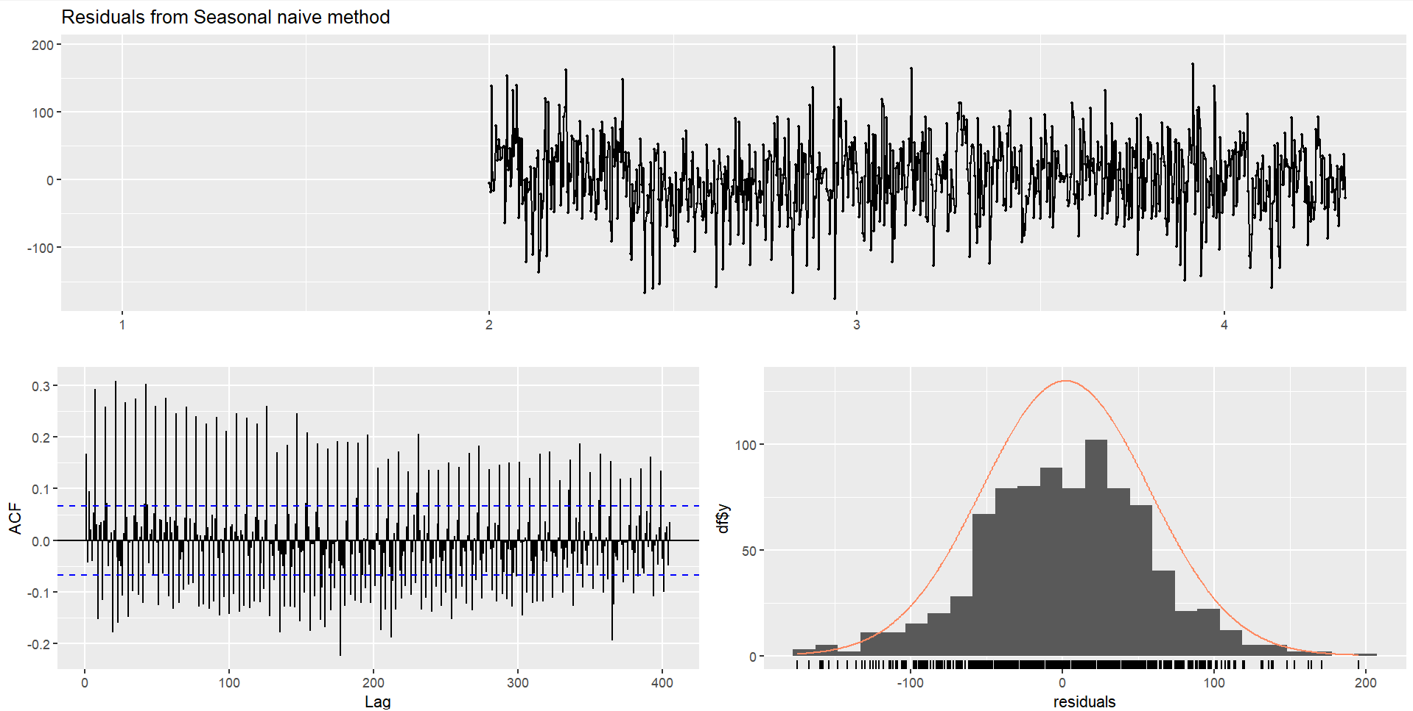
Modeling - Seasonal Naive
A seasonal naive model has been developed as a benchmark model to evaluate the trends for a 365-day forecast.
The forecasts are very jittery and do not seem to capture the variation in the data. They do capture some of the seasonality in the data though, letting it act as a valid benchmark.
The model shows moderate errors and despite a low ACF, it fails the Ljung-Box test (p-value < 2.2e-16), suggesting unreliable predictions. A high positive RMSE of 55.22 shows a scope of improvement with model refinement.

Slide 13
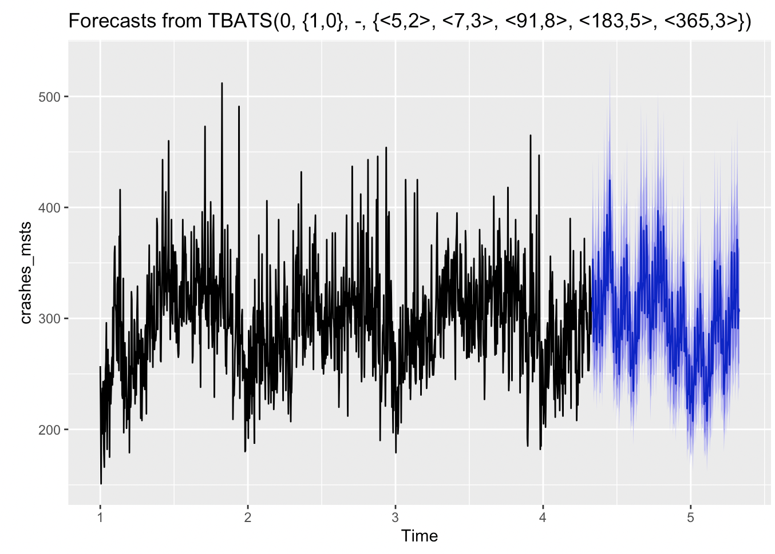
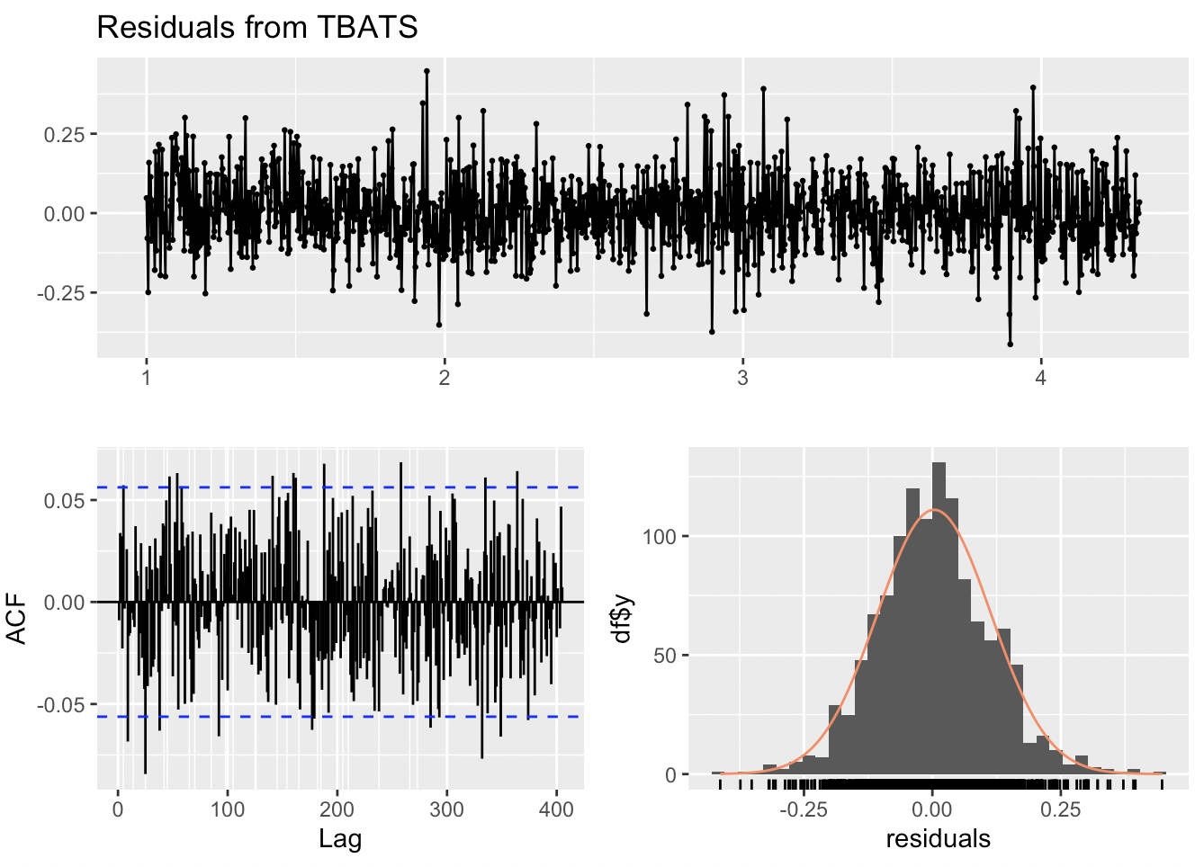
Modeling - TBATS
We fit a TBATS model considering all the seasonal patterns discussed and forecast for a 1-year period. The fitted model is TBATS (0, {1,0}, - , {<5,2>,<7,3>,<91,8>,<183,5>,<365,3>})
The forecast looks like it is able to capture the seasonality in the data.
The residuals are normally distributed, but the model fails the Ljung box test with a p-value of 0.001. The ACF plot also suggests that there are some significant lags and some seasonality which is not captured by the model fit.

Slide 14
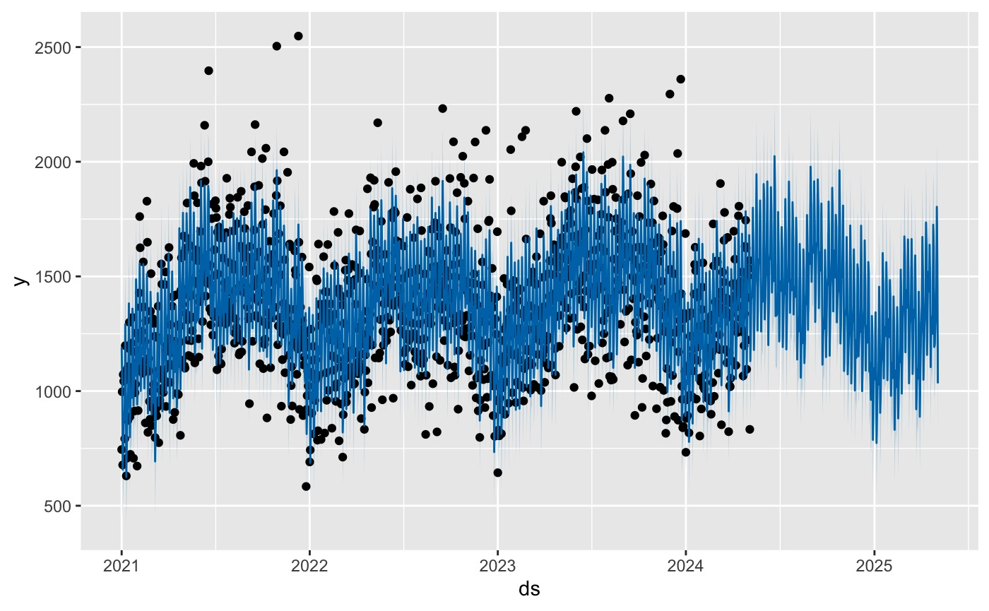
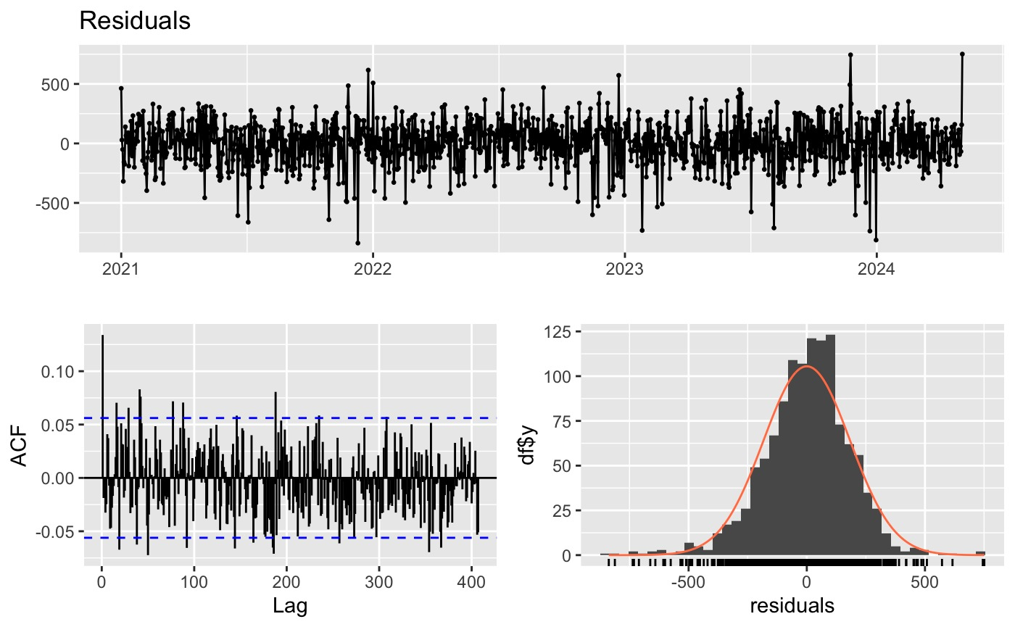
Modeling - Prophet
We Used Facebook's Prophet library to fit a model with 5,7,183 and 365 periodicity seasonality's to predict the number of crashes.
Forecasts from the model look reasonable in their predictions of the future, following trends that we can see in the training set. There are some outliers in the data, which contribute to our High RMSE value as seen in the scatter.
Given that the model does seem reasonable, The residuals still do not pass the Ljung-Box test with a p-value of 2e-3. This model has not explained all the variance in the data even if the RMSE and MAPE value is one of the lowest.

Slide 15
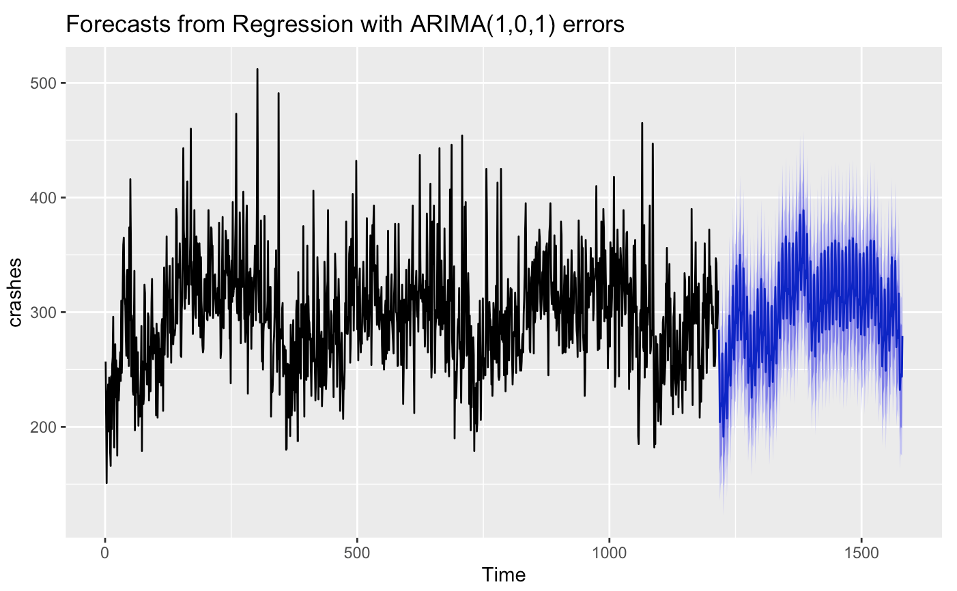
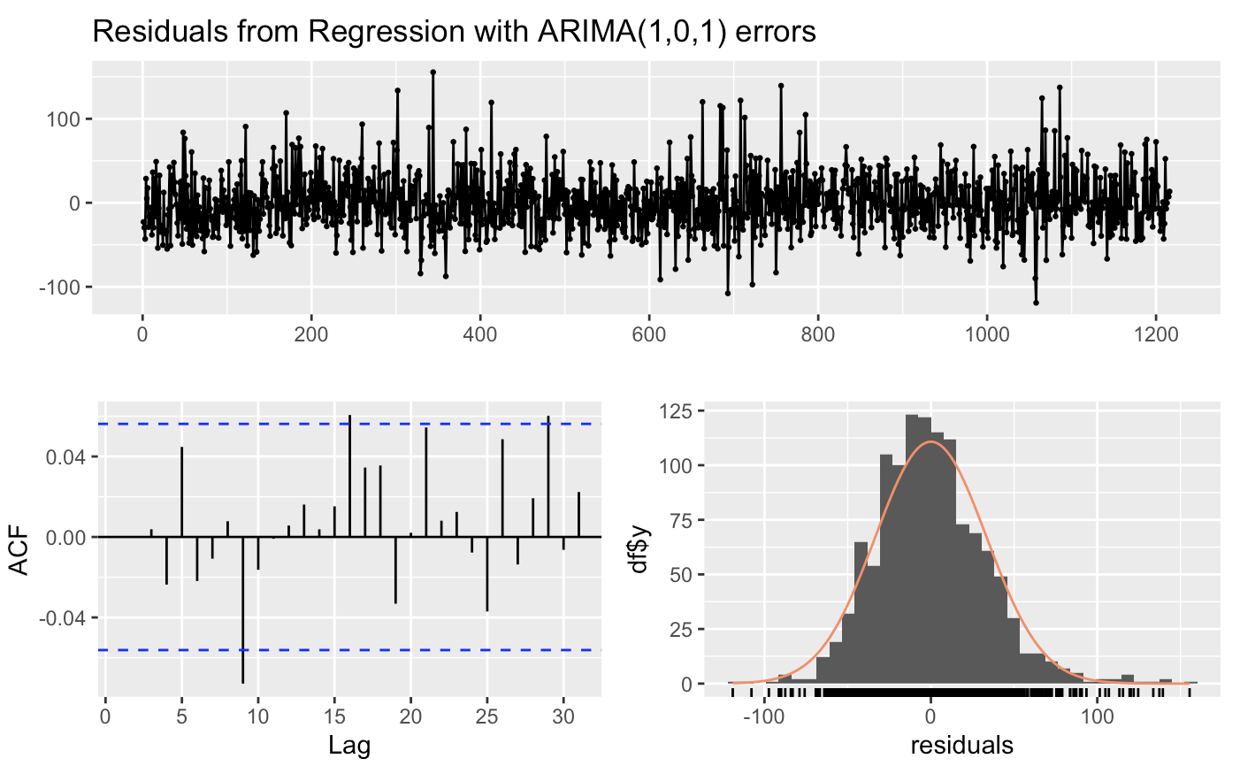
Modeling - ARIMAX
ARIMAX Model: We use Fourier terms and fit a model using the auto.arima() function. It fits a Regression with ARIMA(1,0,1) errors
Forecasts from the model look reasonable, and the model is able to capture the underlying patterns and seasonality in the crashes data.
The model residuals pass the Ljung-Box test with a p-value of 0.21 and are fairly normally distributed. The ACF plot also does not show any significant pattern of correlation between the lags. This model is our best model.

Slide 16
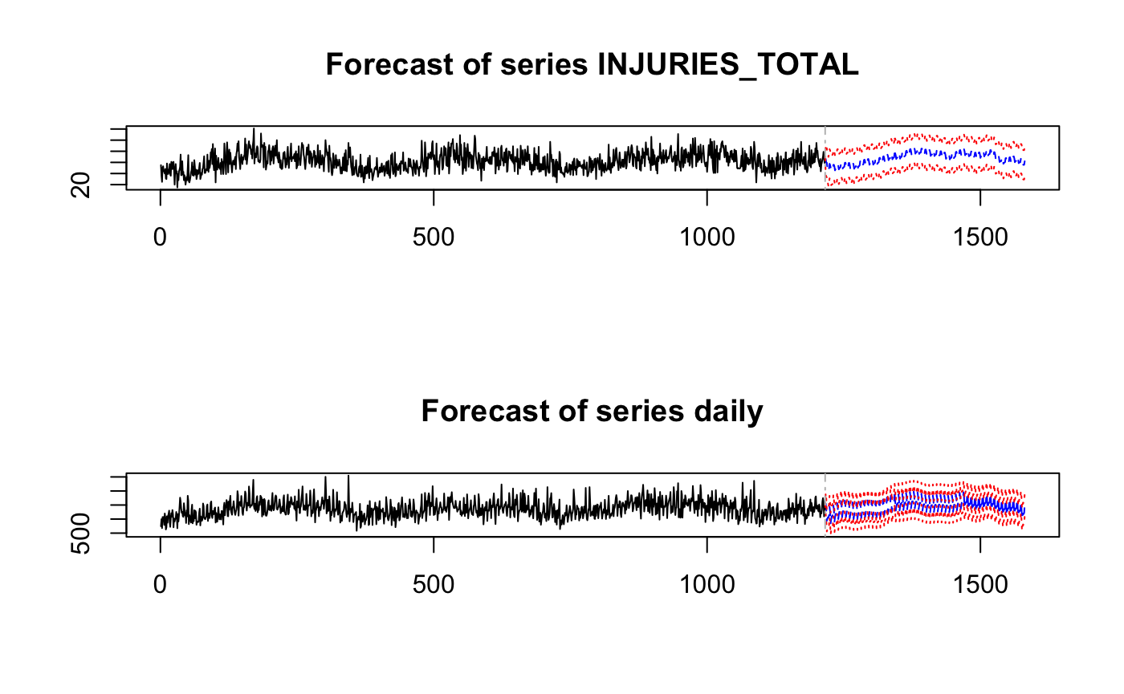
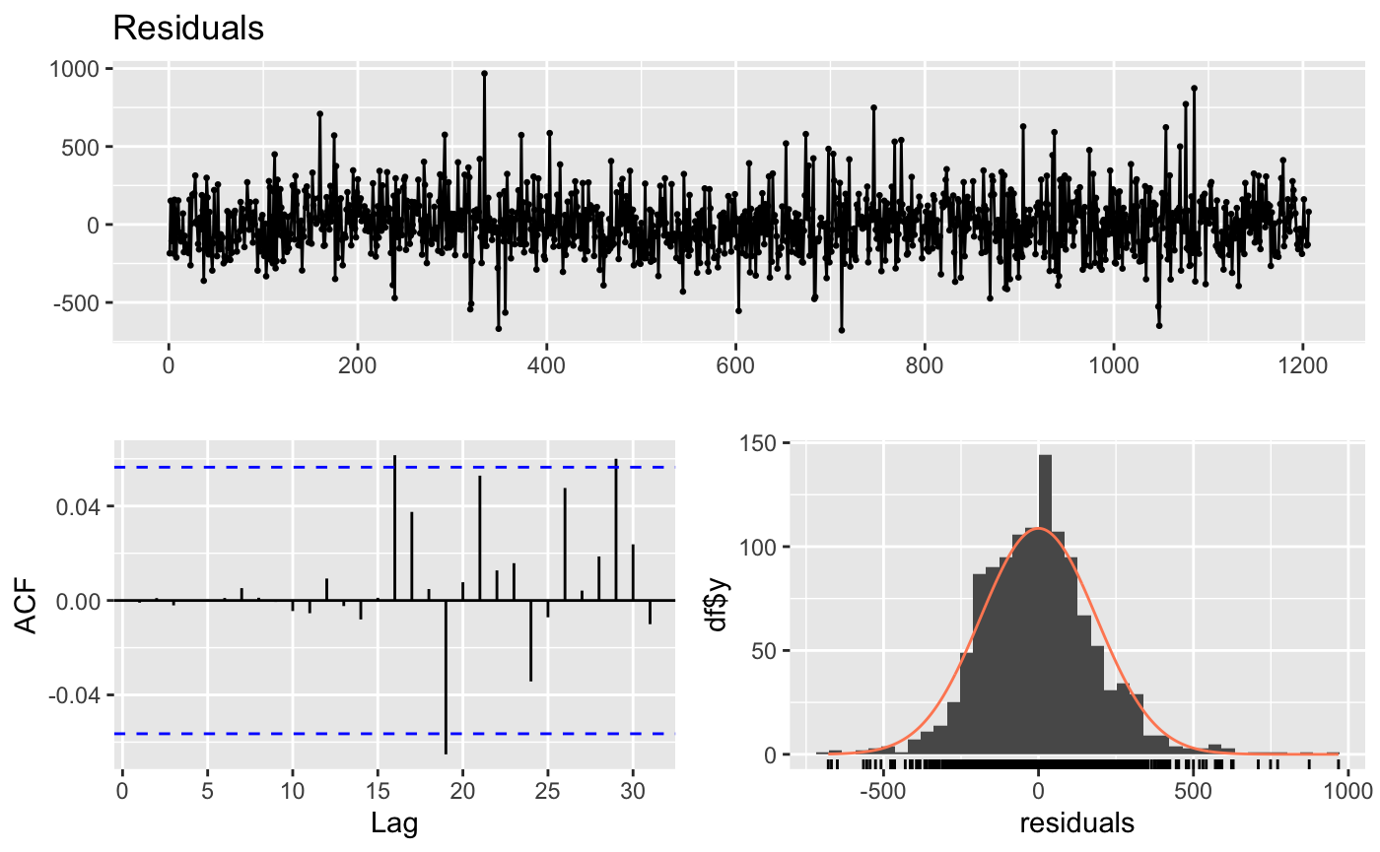
Modeling Injuries - VAR
We Used a VectorAutoRegressive model to predict the Number of Injuries using the number of crashes and added seasonality's using Fourier terms.
The VAR model performs quite well on the predictions with a tight confidence interval and mirroring the observed seasonality.
The Residuals of this model look quite normally distributed, low autocorrelation is confirmed by the Ljung Box test with p-value of 0.14. This model performs quite well with an RMSE of 12.7 and MAPE of 17.96 but still falls behind other models

Slide 17
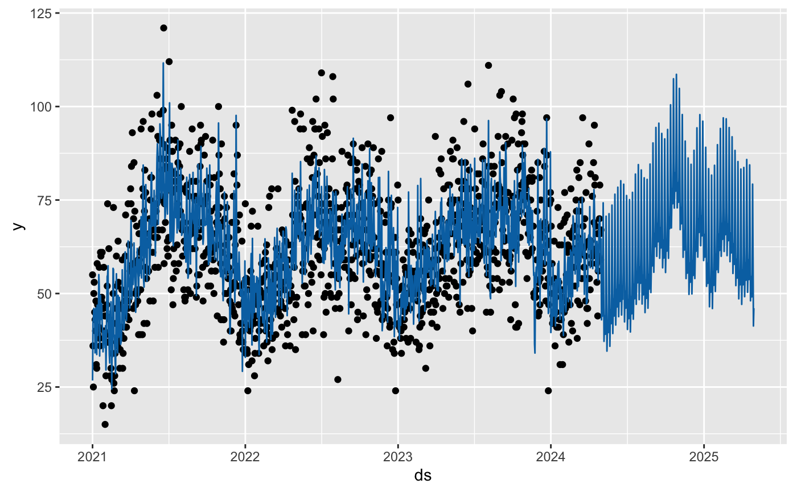
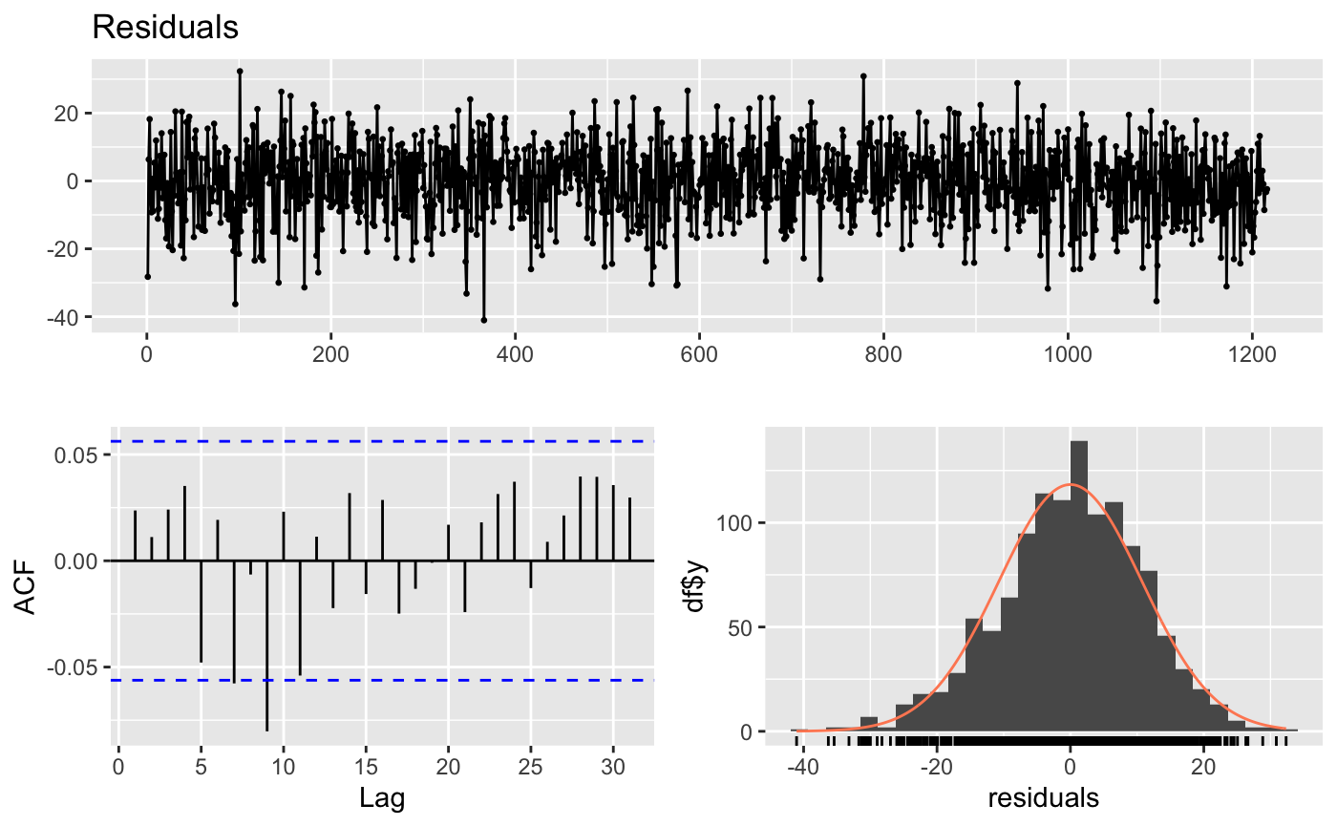
Modeling Injuries - Prophet
We Used Facebook's Prophet library to fit a model with 7 and 365 periodicity seasonality's. We additionally added the Number of crashes as an external regressor to help predict the number of injuries
Forecasts, from the model are really variant as we can see from the fast changes in seasonality. They do not seem to be a good representation of reality.
The model does not pass the Ljung Box test with a p-value of 0.04 even after having a low RMSE and MAPE values of 10.74 and 14.93 respectively. Echoing our previous assumptions. Prophet is Overfitting to the Series.

Slide 18
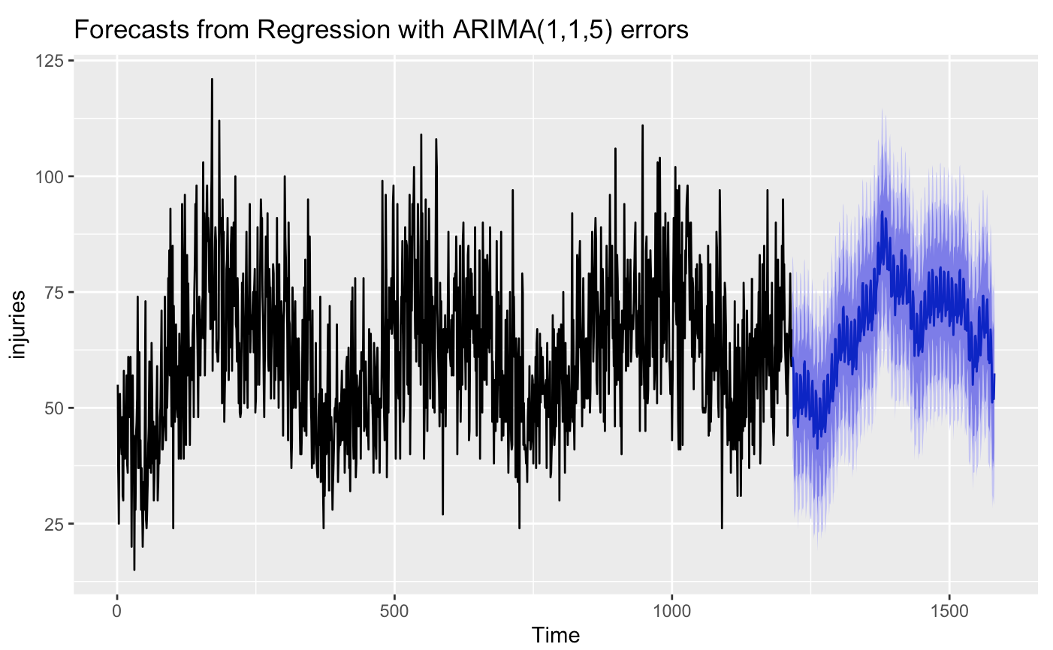
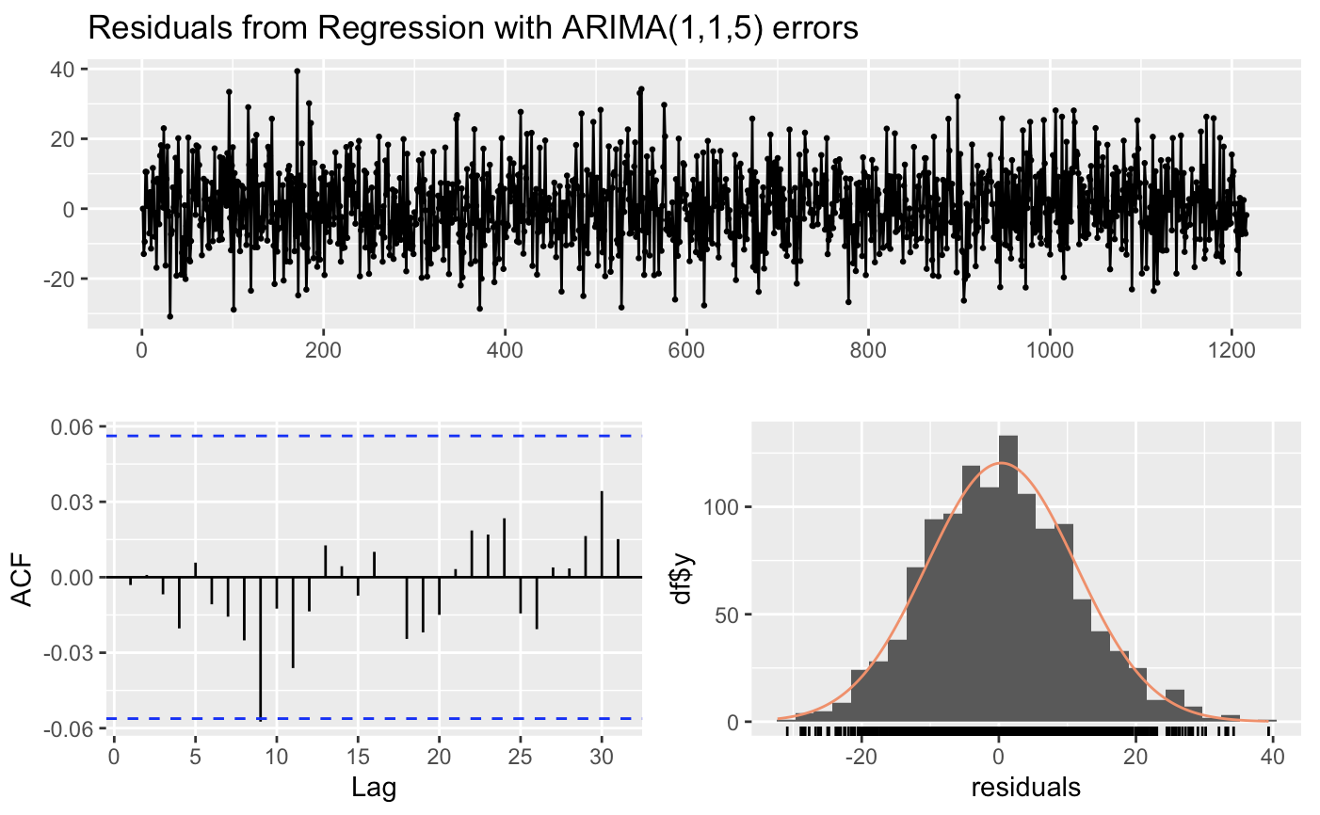
Modeling Injuries - ARIMAX
ARIMAX Model: We use Fourier terms for injuries and combine with crashes to fit a model using the auto.arima() function. It fits a Regression with ARIMA(1,1,5) errors
We used the predicted values for crashes from ARIMAX model (for crashes) to feed as one of the regressors for this multivariate model. The model is able to predict injuries based on crashes and handle multiple seasonality in data.
The model residuals pass the Ljung-Box test with a p-value of 0.194 and are normally distributed. The ACF plot does not show any significant lags. This model is also our best model with and RMSE of 10.88 and a MAPE of 15.22

Slide 19
Model Evaluation and Selection
CRASHES
Model | RMSE | MAE | MAPE | Residuals Ljung-Box Test | P-value
SNAIVE | 55.2 | 43.2 | 14.6 | Fail | 2.2e-16
TBATS | 33.2 | 25.3 | 8.6 | Fail | 1e-3
PROPHET | 33.1 | 25.2 | 8.6 | Fail | 2e-3
ARIMAX | 33.3 | 25.6 | 8.7 | Pass | 0.21
STLM | 34.2 | 26.1 | 8.7 | Fail | 2.2e-16
INJURIES
Model | RMSE | MAE | MAPE | Residuals Ljung-Box Test | P-value
PROPHET | 10.7 | 8.4 | 14.9 | Fail | 4e-2
ARIMAX | 10.8 | 8.6 | 15.2 | Pass | 0.19
VAR | 12.7 | 10.2 | 17.9 | Pass | 0.14

Slide 20
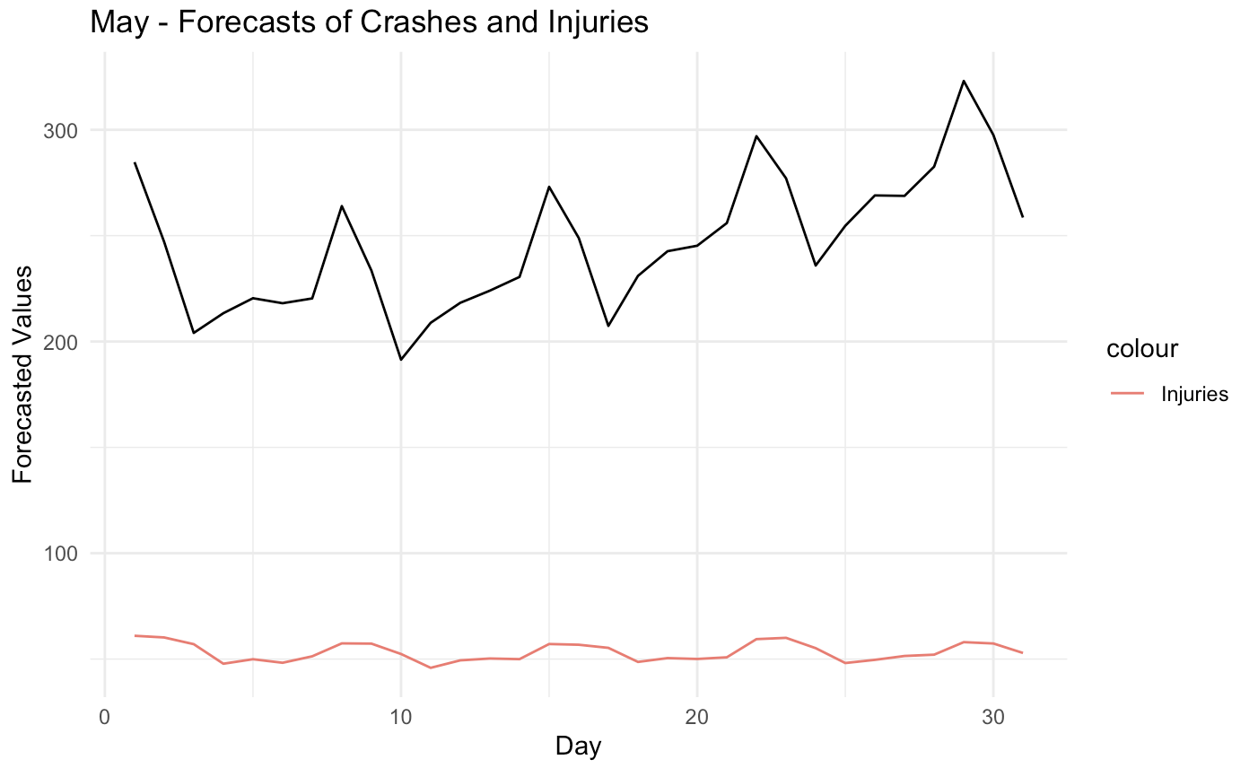
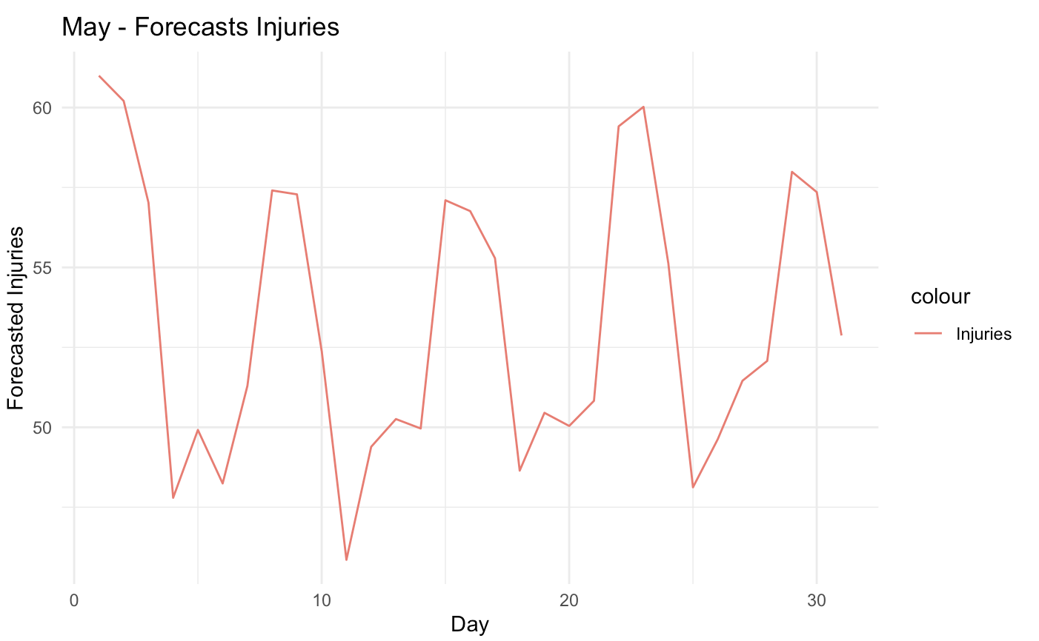
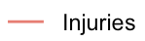
Results - May 2024 Forecasts
We use our best models [ARIMAX models for crashes and injuries] to generate forecasts for May 2024. These results can enable the law enforcement agencies and healthcare facilities to manage workload.
Forecasted crashes for May indicate the following:
Most crashes in the last week of May
More crashes on dates 1st, 8th, 15th, 22nd, 23rd
This can be useful for law enforcement agencies
Forecasted injuries for May indicate the following:
Most injuries in the third week of May
More injuries on dates 1st, 2nd, 8th, 9th,15th, 16th
This can be useful to guide the healthcare facilities

Slide 21
Future Scope
Granularity
Further down sampling the data to Hourly data will enable us uncover more complex patterns
Modeling
Experimental analysis of data and modeling to give hourly predictions for crashes and injuries
Improvements
Use cross-validation techniques for model improvement. Incorporate more data (for eg. Weather, Traffic data)
Recommendations
Customised for law enforcement agencies and healthcare facilities by the hourly forecasts
More sophisticated models will allow policymakers to simulate the effects of various traffic laws and infrastructure changes before implementation. Forecasted data can be increasingly used to design targeted public safety campaigns, focusing on times and locations where data predicts high risk.

Slide 22
Thank You!

Slide 23
Appendix
Data Preparation/Aggregation
Differencing for time series stationarity
Modeling crashes – STLM()
Modeling crashes – ARIMAX coefficients
Residuals Linear model – TSLM()

Slide 24
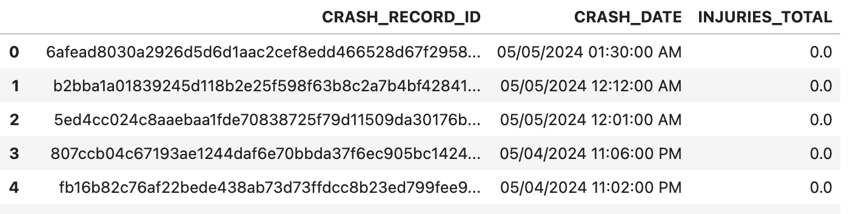
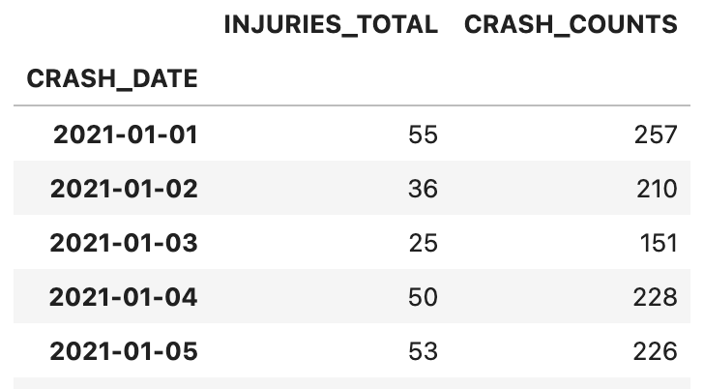
Data Preparation
Raw Data
Final Data
The raw data has a unique row for each crash and a timestamp associated with the crash.
Each row also has the total number of injuries associated with that crash.
We extracted date from timestamp and down sampled the data to day level data. Aggregated the data to calculate crashes and injuries as follows:
Crashes = Count(Rows)
Injuries = Sum(Injuries)

Slide 25
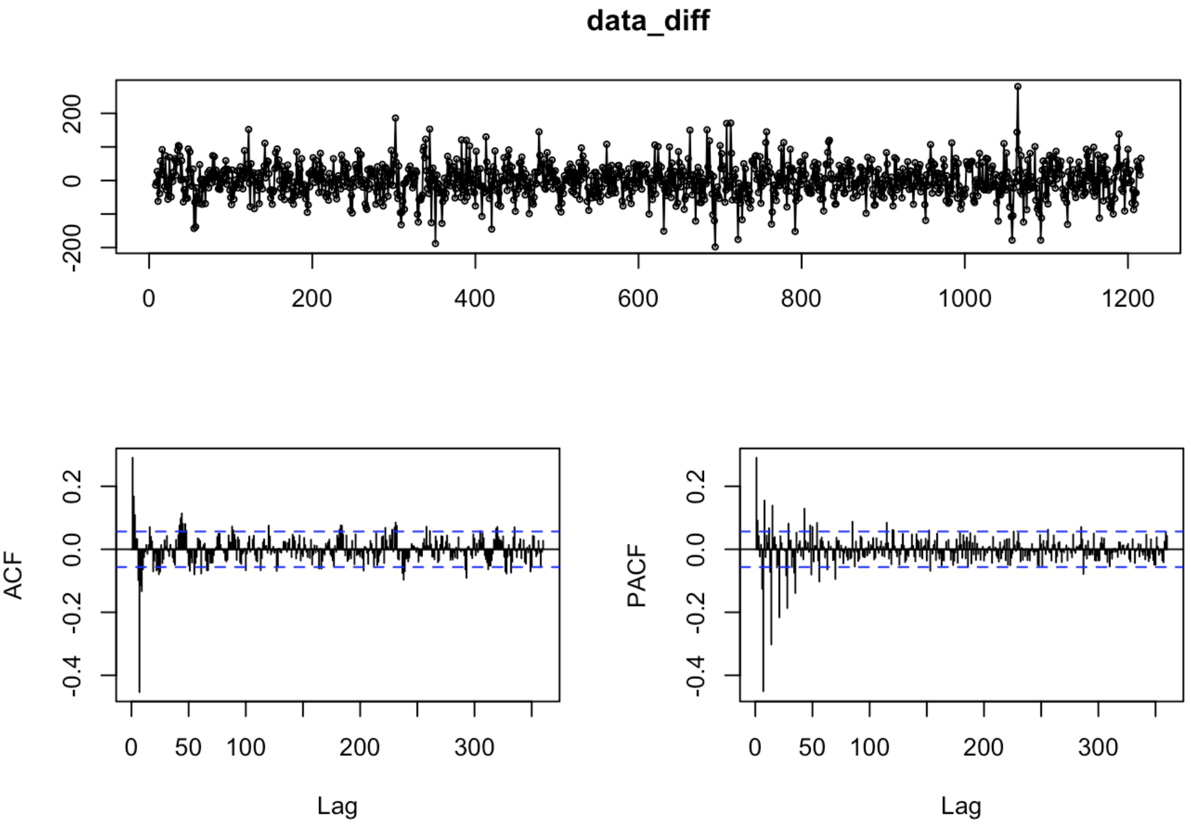
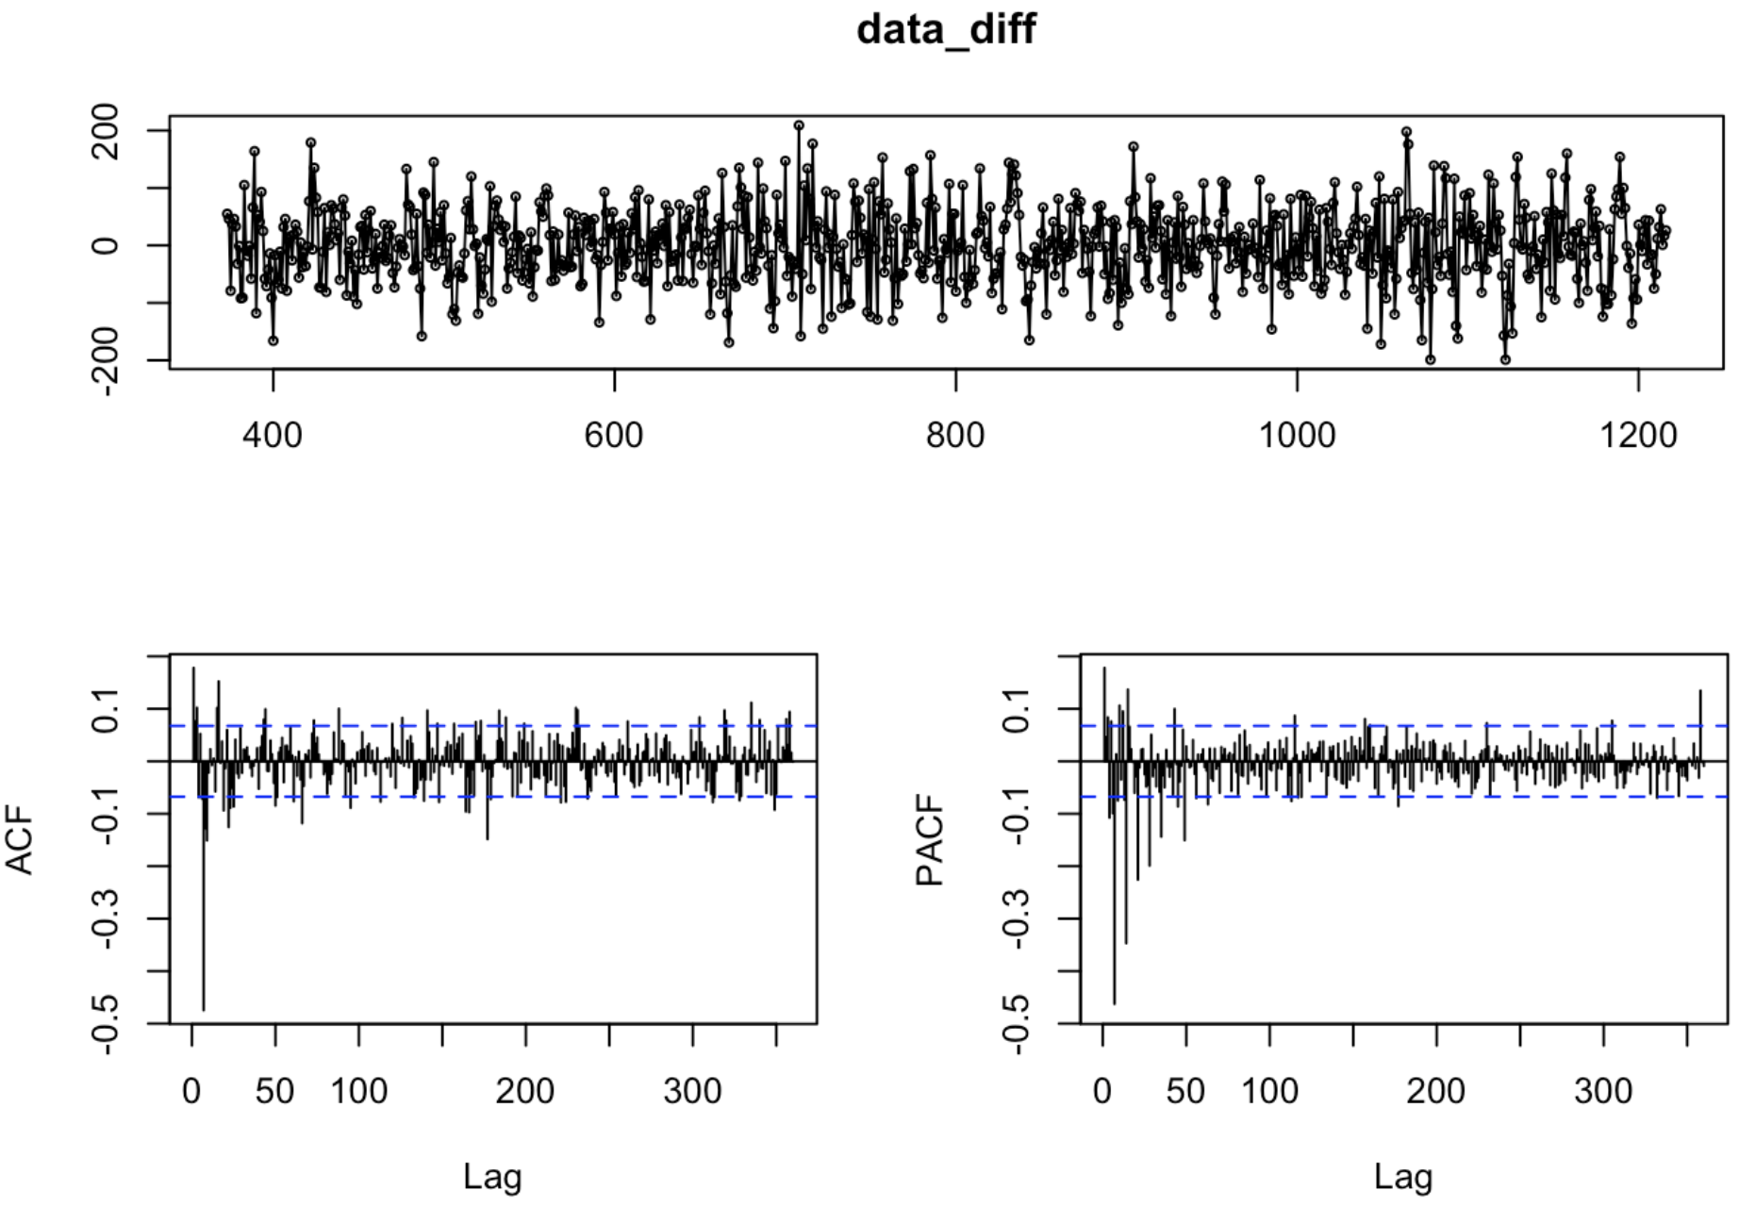
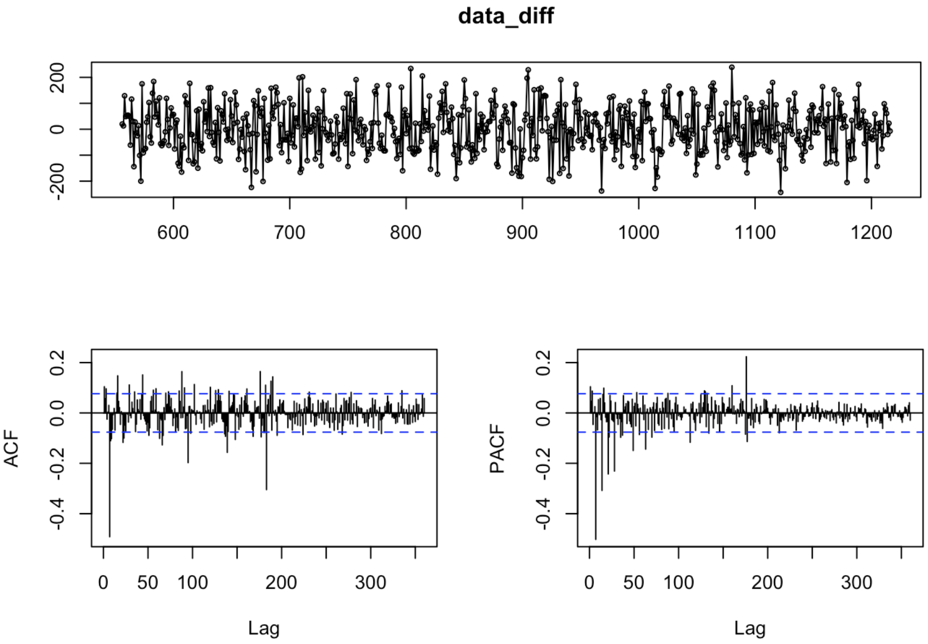
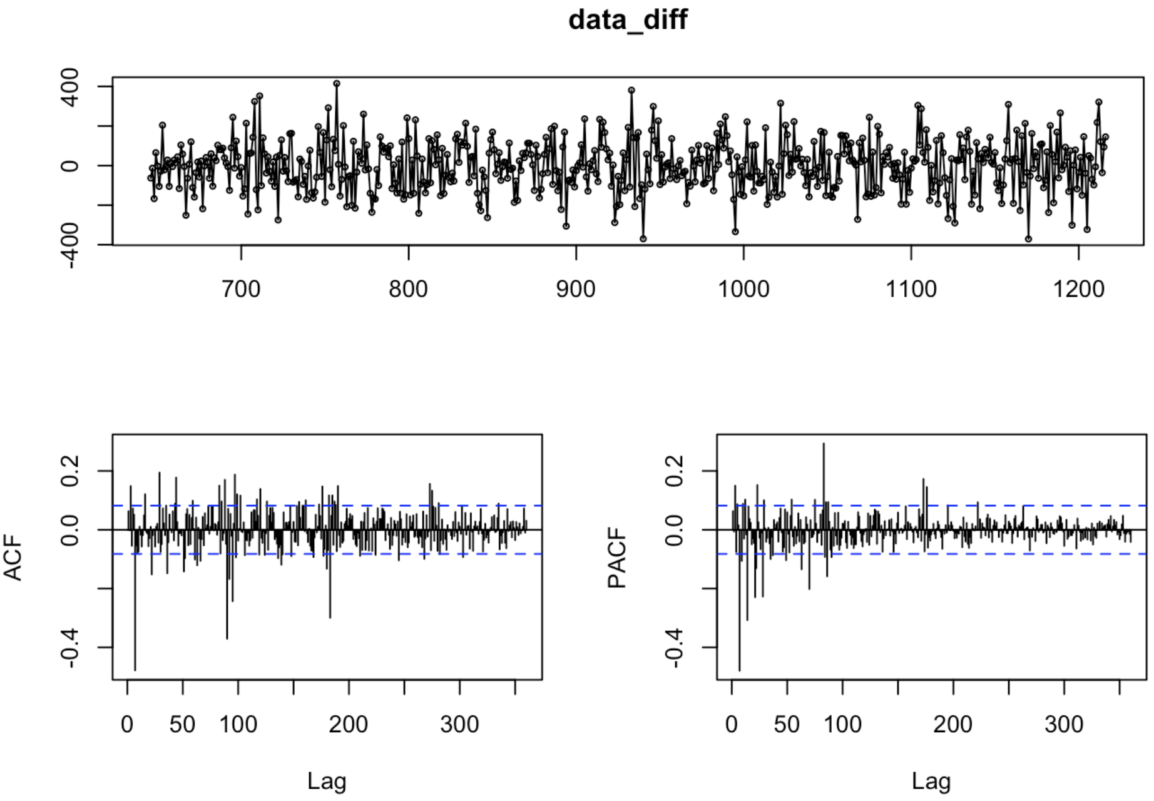
Data Differencing
After 4 rounds of seasonal differencing of the data, we were able to achieve near stationarity.
Passes Ljung-Box test with a p-value of 0.1289
Passes Augmented Dickey-Fuller test with a p-value of 0.01
Passes KPSS test for level and trend stationarity with p-values 0.1 each

Slide 26
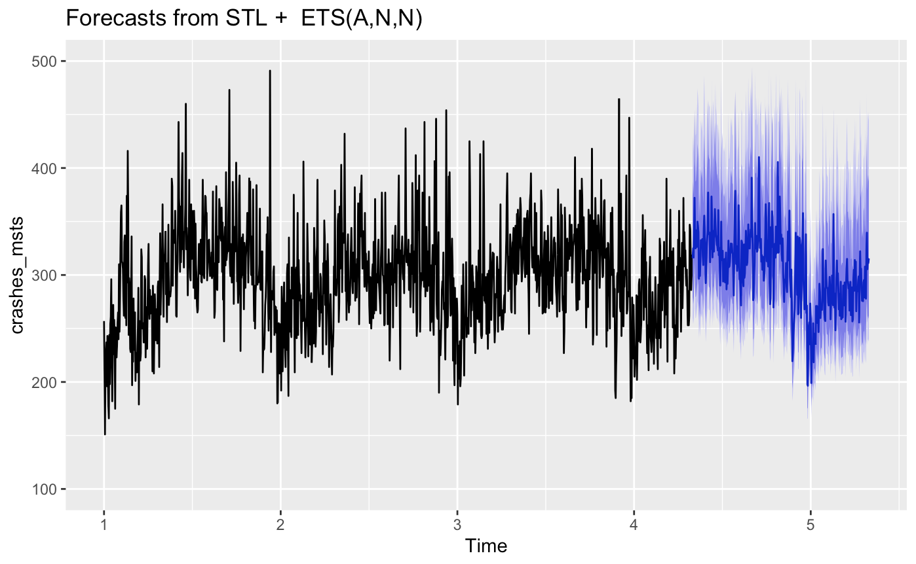
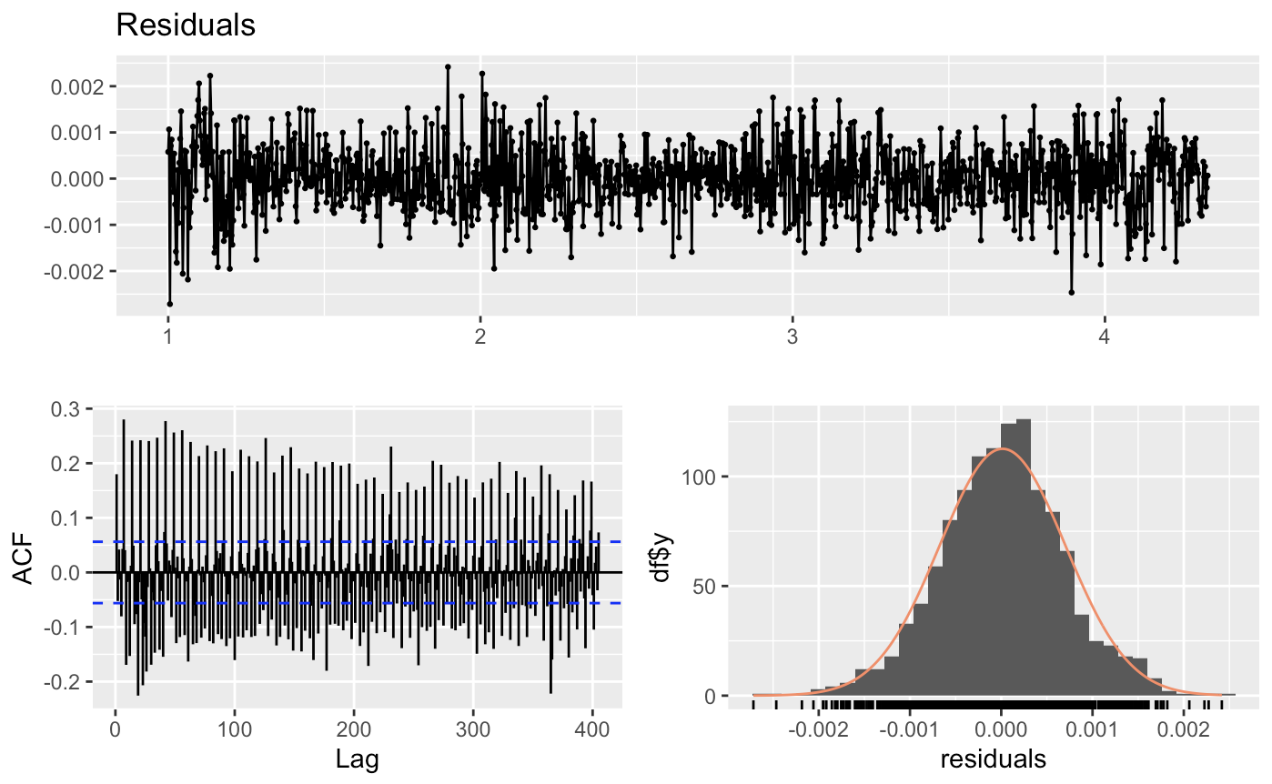
Modeling - STLM
STLM is used to fit a model to the crashes data with multiple seasonal periods 5,7,183 and 365. It fits an ETS(A,N,N) model with additive errors. The model is not able to identify and account for the seasonality.
Even though the forecasts look reasonable and in line with the overall pattern of the data, the residuals are highly autocorrelated hence not a reliable model.
The model residuals fail the Ljung-Box test (p-value < 2.2e-16), suggesting high autocorrelation between residuals with multiple significant lag. We can see seasonality in residuals.

Slide 27
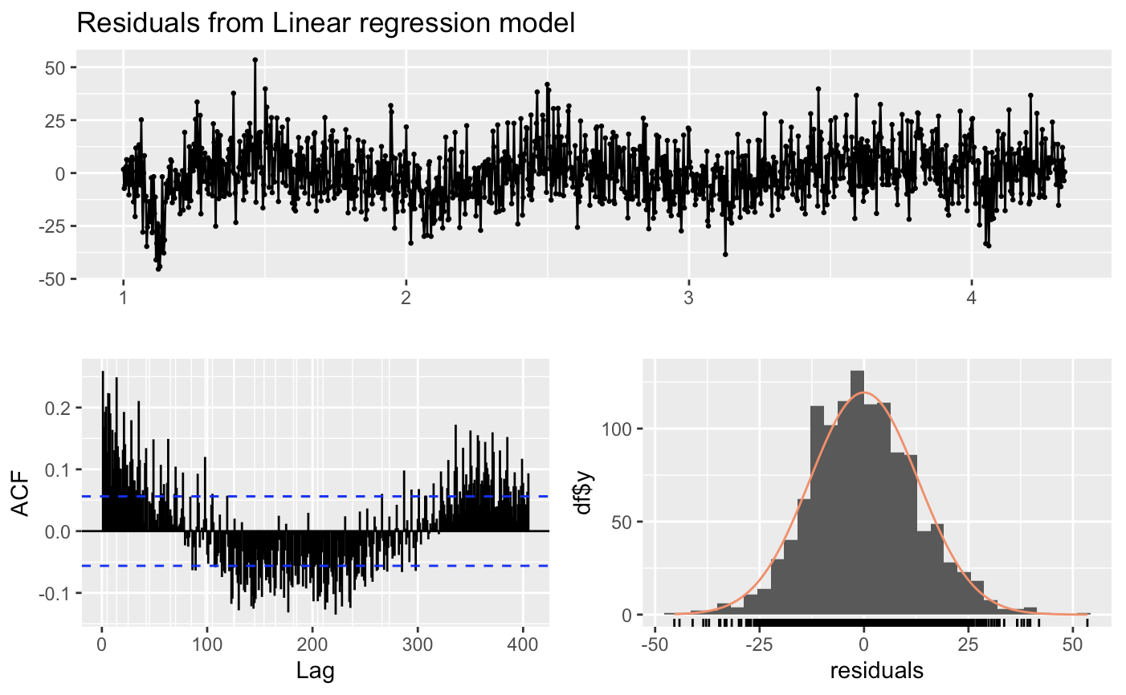
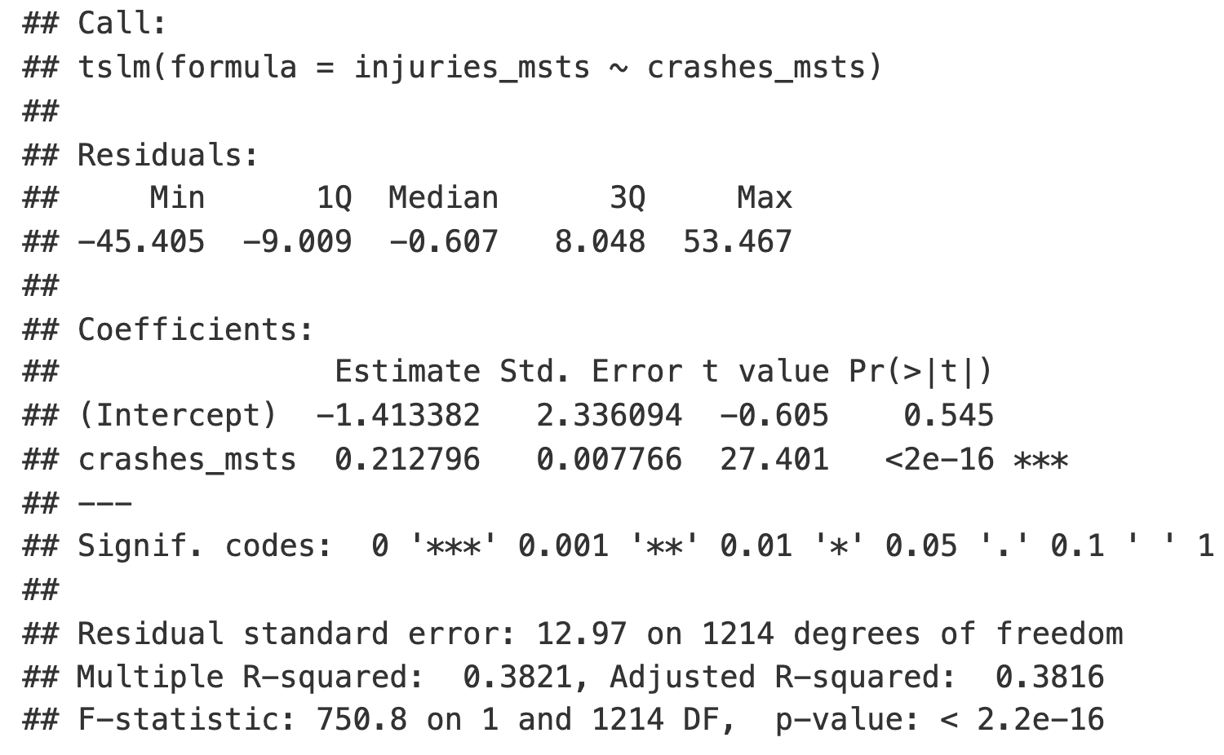
Residuals of Linear model
The model has R squared of 0.38, which means that crashes time series is able to capture 38% variation in the injuries time series. However, the residuals show seasonality and clearly indicate that the model has not been able to capture the underlying patterns in the data.

Slide 28
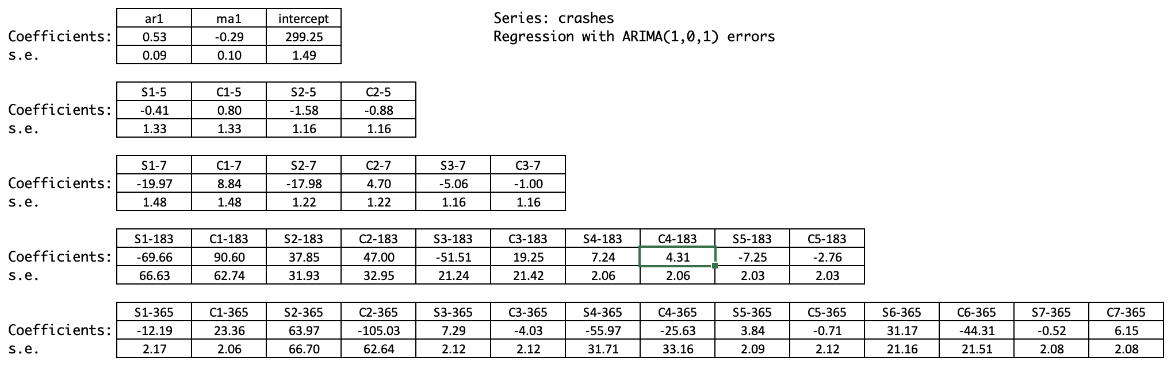
Modeling crashes – ARIMAX coefficients
The Regression with ARIMA errors model uses fourier terms as regressors. For each of the seasonal component, an optimal value of K was chosen using multiple iterations and trials. The K values for each seasonal component are: (5: K = 2), (7: K=3), (183: K=5), (365: K=7)
There are total 37 coefficients: 1 for intercept, 1 for AR term, 1 for MA term and 17 each for sin and cos coefficients of the fourier terms

